Slide 1
Comp 4350 Software Engineering II Lecture 5
Dr. Shaowei Wang

Slide 2
Administrative items
Meet TA next week for sprint 1 evaluation.
Submit project proposal by next Friday to UMLearn (Assignment -> project proposal)
We will have presentation to introduce your project next week.
Find the schedule in the project google spreadsheet
Submit slides before your presentation to UMLearn (Assignments-> Project proposal presentation)

Slide 3
Agenda
Regression testing
Continuous deployment
Tutorial on Docker

Slide 4
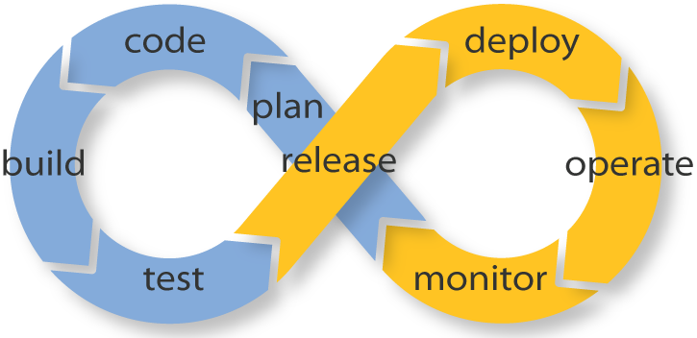

System Building and Release Pipelines

Slide 5
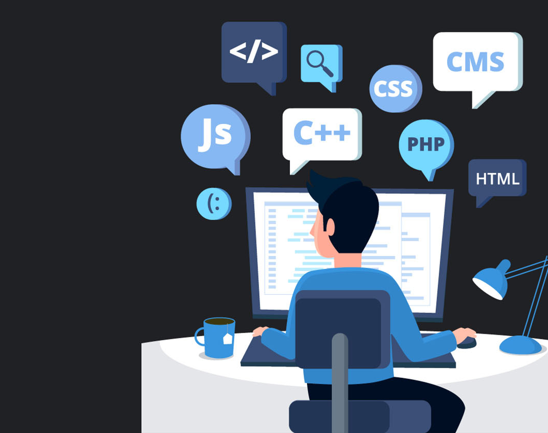
Regression testing

Slide 6
Regression testing
A software testing practice that ensures an application still functions as expected after any code changes, updates, or improvements.
Goal
Make sure the changes in code does not break existing functional and non-functional requirement of the system.
Find defect in early stage.

Slide 7
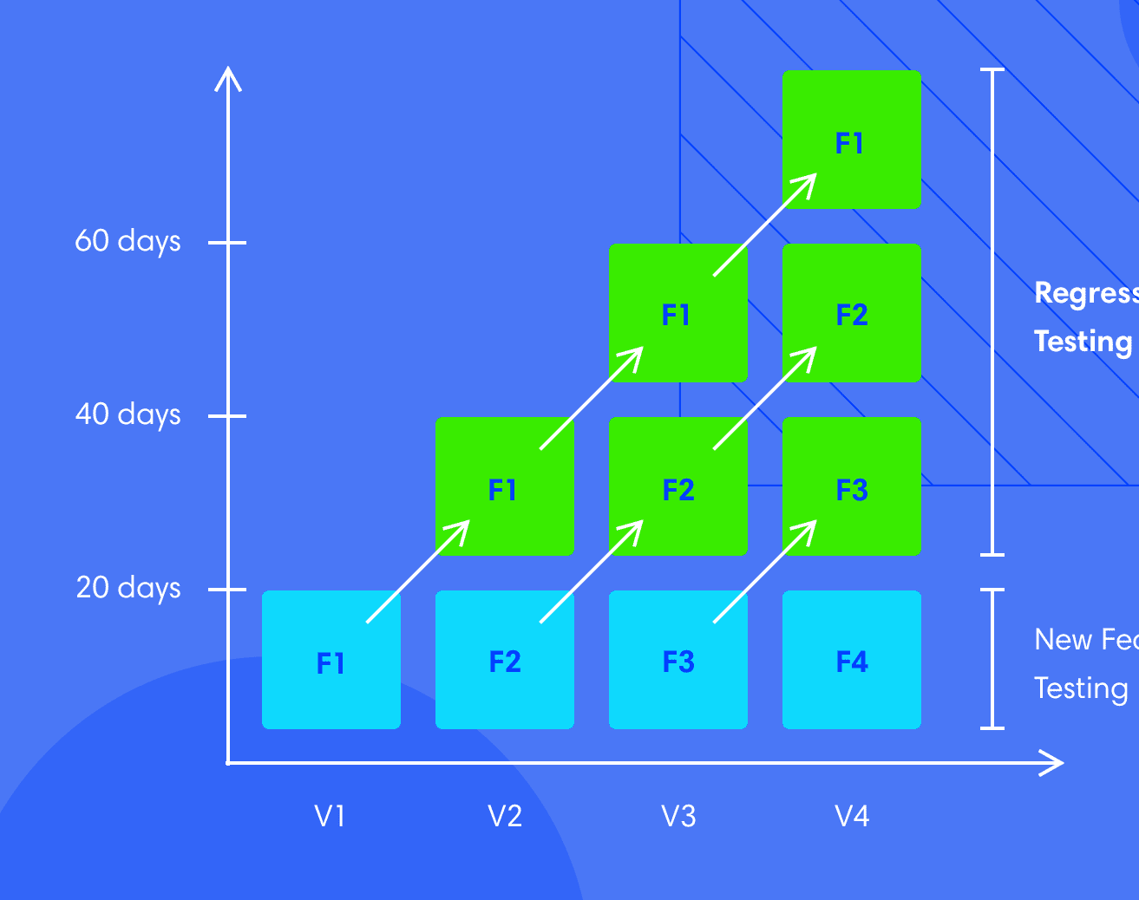
Earlier features get more exercise!

Slide 8
How to do regression testing?
Regression testing uses test cases that have already been used but are re-executed to make sure that the software still works the way it did before changes were made.
Can be done in different levels:
Unit testing
Integration testing
System testing
Acceptance testing

Slide 9


Complete vs partial ?

Slide 10

Quality (e.g., coverage)
Cost (e.g., time/resource)

Slide 11
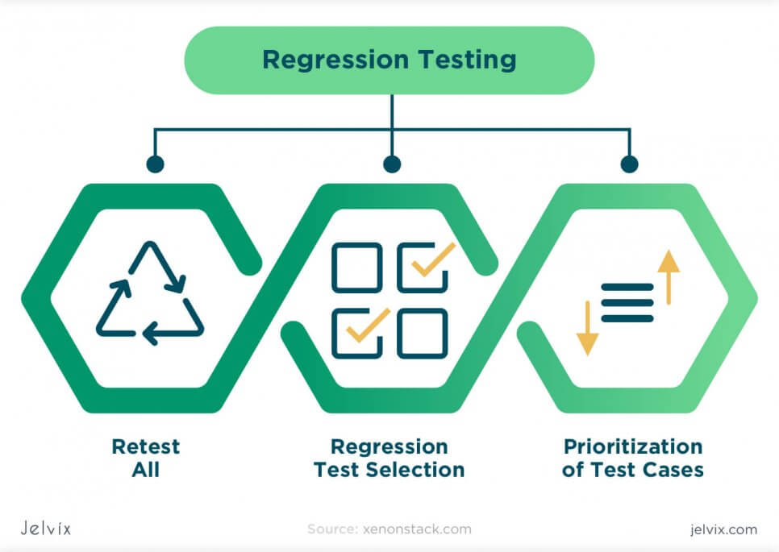

Slide 12
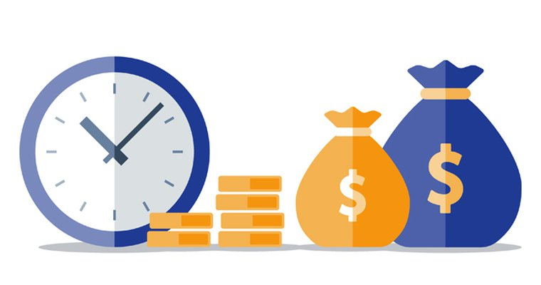
Complete regression - expensive
Complete regression tests are conducted when:
The software updates affect the foundation of the code;
If there are multiple changes added to the code; or
If the update greatly affects the codebase
No free lunch!

Slide 14
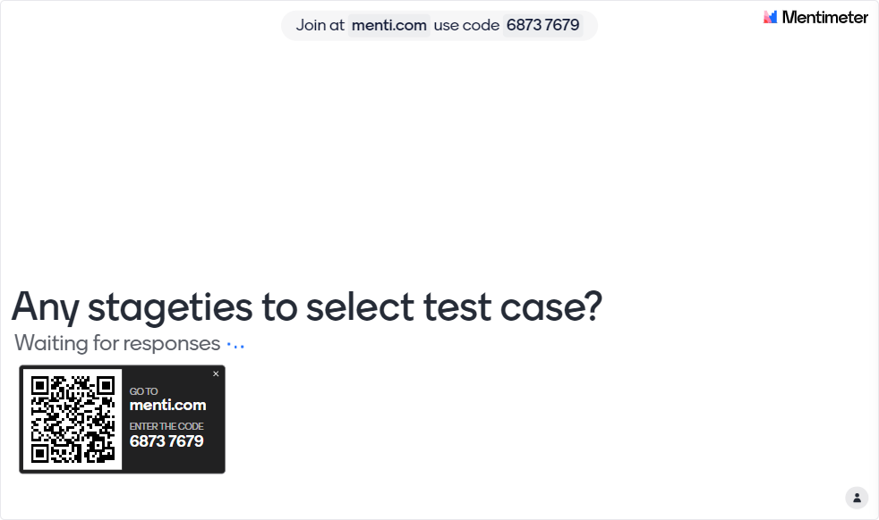

Slide 15
Tips for test cases selection/prioritization
Select test cases for Regression testing where there are recent code changes or functional changes.
What do we need?
Requires the link between code and test cases

Slide 16
Class A
Class B
Class C
Class D
Class E
System X
Test case 1
Test case 2
Test case 3
Class A
Class A
Class B
Class B
Class B
Class E
Class C
Class D
Class C

Slide 17

Class A
Class B
Class C
Class D
Class E
System X
Test case 1
Test case 2
Test case 3
Class A
Class A
Class B
Class B
Class B
Class E
Class C
Class D
Class C

Slide 18
Tips for test cases selection/prioritization
Select test cases for Regression testing where there are recent code changes or functional changes.
Select test cases for Regression testing in areas with frequent bugs/defects.
What do we need?
Requires the link between code and test cases
Requires the history of the bug fixing
Notes:
Files with bug recently are more likely to happen again.

Slide 19
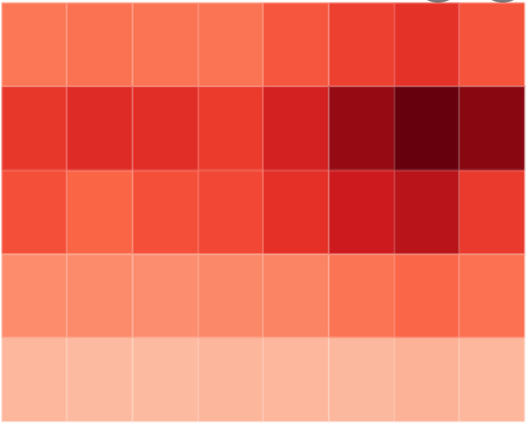
Defects frequency heatmap

Slide 20
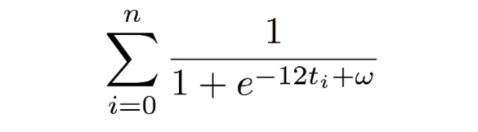



Defect prediction at Google
Score (f) =
The score is based on two factors: how many bugs have ever happened in f, and how old are they.
Decided to score each file by weighting each bug-fixing commit by how old it is. As the commit gets older, so its influence tends towards 0.
Where n is the number of bug-fixing commits, and t_{i} is the timestamp of the bug-fixing commit represented by i.
http://google-engtools.blogspot.com/2011/12/bug-prediction-at-google.html

Slide 21
Tips for test cases selection/prioritization
Select test cases for Regression testing where there are recent code changes or functional changes.
Select test cases for Regression testing in areas with frequent bugs/defects.
Choose test cases with critical functionalities.
…

Slide 22
Regression testing can be done in any level and should select tests from various level
Unit testing
Integration testing
System testing
Acceptance testing

Slide 23
Acceptance testing
An individual acceptance test is intended to verify that the acceptance criteria of a story or requirement have been met.
The goal is asserting that a user/customer has what they need.
Type of acceptance testing
Functional
Non-functional (performance, capacity)

Slide 24
Why Is Automated Acceptance Testing Essential?
Rapid release for modern software system (Web/Mobile Apps).
Manual acceptance testing is expensive and slow
one organization that spends $3,000,000 on manual acceptance testing for every release.
Acceptance tests also protect your application when you are making large-scale changes to it.
Notes:
Thus manual testing usually happens at a time in the project where teams are under extreme pressure to get software out of the door. As a result, insufficient time is normally planned to fix the defects found as part of manual acceptance testing. Finally, when defects are found that require complex fixes, there is a high chance of introducing further regression problems into the application.1

Slide 25
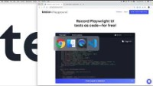
Automate Functional testing tool - TESTIM
https://www.testim.io/blog/regression-testing/

Slide 26
Drawback
Won’t work properly if UI is modified (UI perspective)
Apply it once your UI is stable

Slide 27
Agenda
Regression testing
Continuous deployment
Tutorial on Decker

Slide 28
Continuous Deployment
A software production process where changes are automatically deployed to production without any manual intervention
(see addendums to lecture notes from DZone)

Slide 29
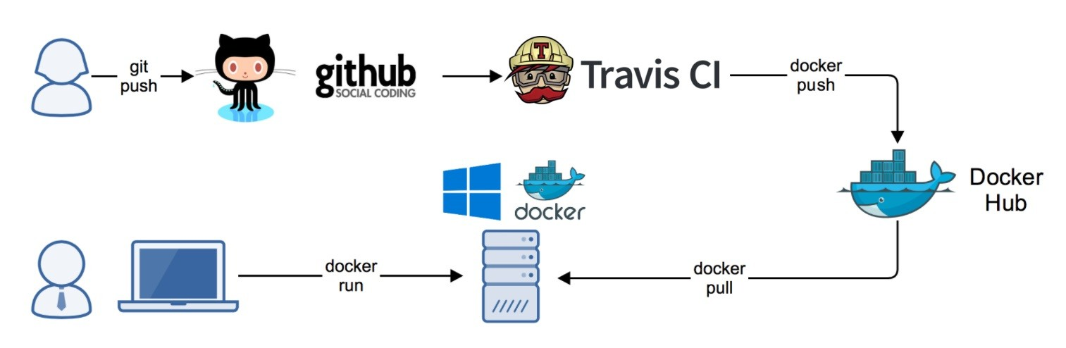
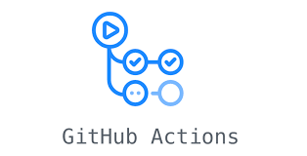
Typical deployment pipeline
Production environment

Slide 30
Releasing strategies
How can we safely deploy our releases to a large number (e.g., missions to billions) of users?
Blue-green deployments
Canary Releasing
A/B Testing

Slide 31
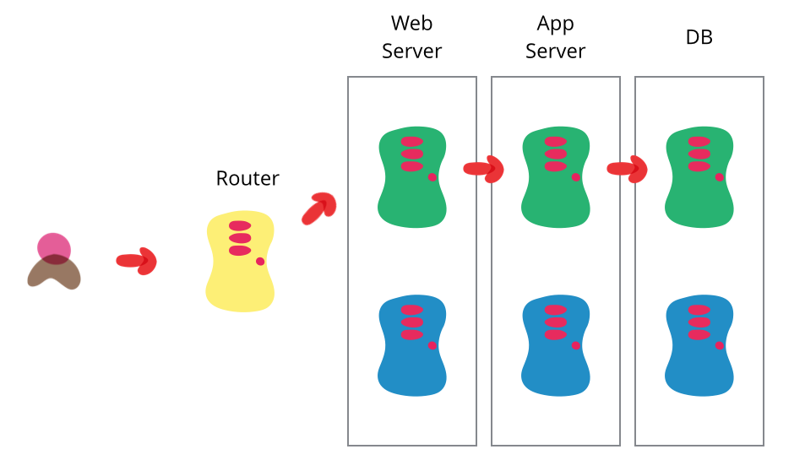
Blue-green deployments
Reduce downtime and risk by running two identical production environments called Blue and Green.
At any time, only one of the environments is live, with the live environment serving all production traffic.
new
old
Source: https://martinfowler.com/bliki/BlueGreenDeployment.html
Notes:
Blue-green deployment also gives you a rapid way to rollback - if anything goes wrong you switch the router back to your blue environment.

Slide 32
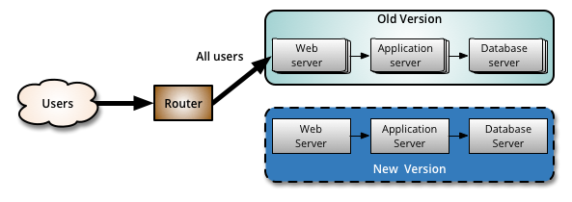
Canary Releasing
Reduces the risk of introducing a new software version in production by slowly rolling out the change to a small subset of users before rolling it out to the entire infrastructure and making it available to everybody.
1. You start by deploying the new version of your software to a subset of your infrastructure, to which no users are routed.
Source: https://martinfowler.com/bliki/CanaryRelease.html

Slide 33
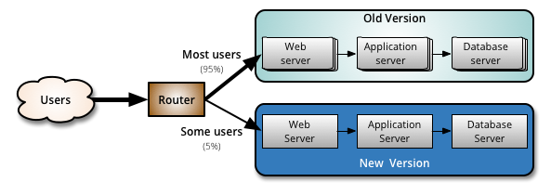
Canary Releasing
Reduces the risk of introducing a new software version in production by slowly rolling out the change to a small subset of users before rolling it out to the entire infrastructure and making it available to everybody.
2. When you are happy with the new version, you can start routing a few selected users to it.
Source: https://martinfowler.com/bliki/CanaryRelease.html

Slide 34
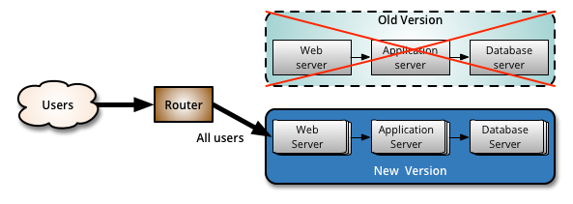
Canary Releasing
Reduces the risk of introducing a new software version in production by slowly rolling out the change to a small subset of users before rolling it out to the entire infrastructure and making it available to everybody.
3. As you gain more confidence in the new version, you can start releasing it to more servers in your infrastructure and routing more users to it, until all the users have been routed to the new version. Then, you can decommission the old infrastructure.
Source: https://martinfowler.com/bliki/CanaryRelease.html

Slide 35
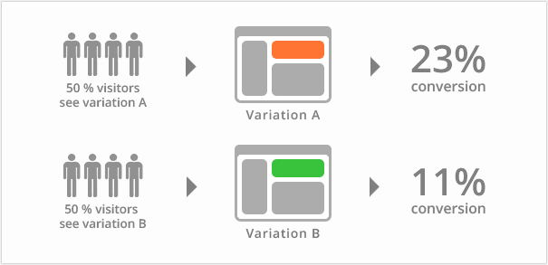
A/B Testing
A/B testing is a way of testing features in your application for various reasons like usability, popularity, noticeability, etc,
Compare A vs B, determine which one is better.
For exploration and experiment
Test a new version of recommendation system, and see it has a higher purchase conversion rate.

Slide 36
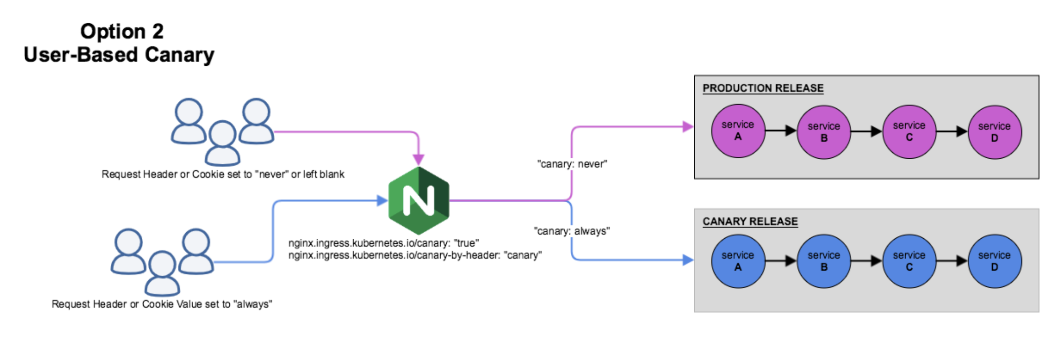
Use nginx to distribute user requests
https://v2-1.docs.kubesphere.io/docs/quick-start/ingress-canary/

Slide 37
Agenda
Regression testing
Continuous deployment
Tutorial on Docker

Slide 38
Good practice in DevOps
Deploy applications in containers
A container is a standard unit of software that packages up code and all its dependencies, so the application runs quickly and reliably from one computing environment to another.

Slide 39
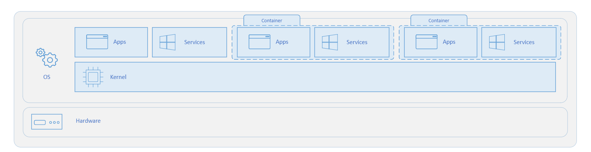
What is container?
A container is an isolated, lightweight silo for running an application on the host operating system. Containers build on top of the host operating system's kernel and share the kernel, and contain only apps and some lightweight operating system APIs and services that run in user mode.

Slide 40
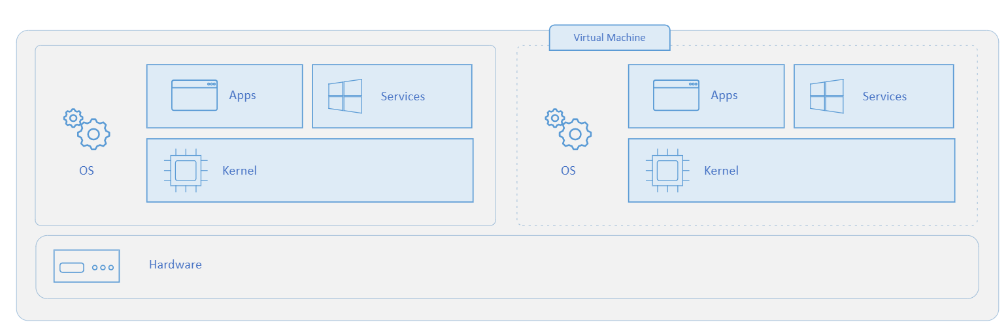
What is a virtual machine (VM)?
In contrast to containers, VMs run a complete operating system–including its own kernel.

Slide 41
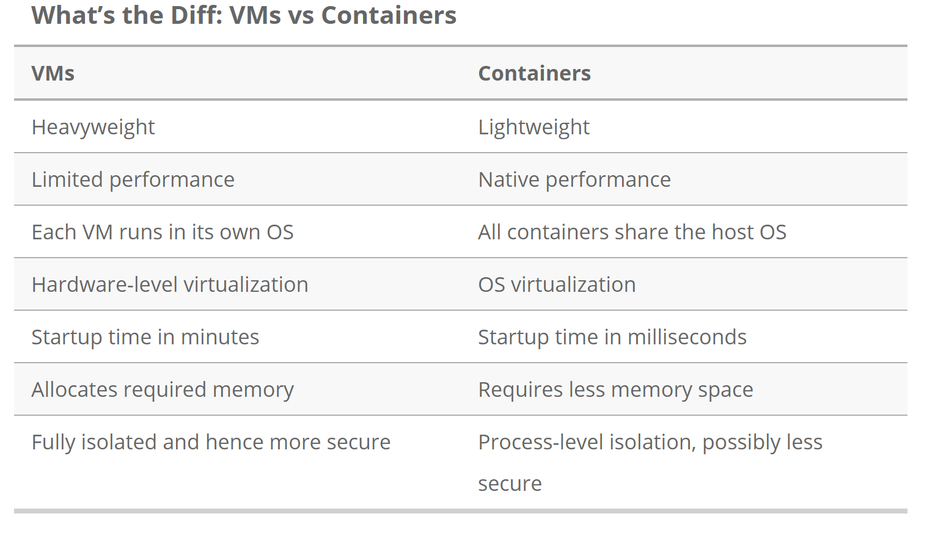
https://www.backblaze.com/blog/vm-vs-containers/
Notes:
3) Performance: Containers are lightweight and consume fewer resources while VM is heavy and consumes more resources, so containers give better performance than VM. Each container shares the host OS kernel and, usually, the binaries and libraries, too. (See below for definitions if you’re not familiar with these terms.)

Slide 42
Benefits of containers
Less overhead Containers require less system resources than traditional or hardware virtual machine environments because they don’t include operating system images.
Increased portability Applications running in containers can be deployed easily to multiple different operating systems and hardware platforms.
More consistent operation DevOps teams know applications in containers will run the same, regardless of where they are deployed.
Better application development Containers support agile and DevOps efforts to accelerate development, test, and production cycles.
Greater efficiency Containers allow applications to be more rapidly deployed, patched, or scaled.

Slide 43
Uses for VMs vs Uses for Containers
VMs are a better choice for running apps that require all of the operating system’s resources and functionality when you need to run multiple applications on servers, or have a wide variety of operating systems to manage.
Containers are a better choice when your biggest priority is maximizing the number of single or limited number of applications running on a minimal number of servers.

Slide 44


Slide 45
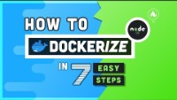

Slide 46
Outline
Step 00 - Installing Docker
Step 01 - A simple Docker use case - Run mysql
Step 02 - Playing with Docker - Containers and Images
Step 03 - Manually creating a docker image
Step 04 – Push image to docker hub

Slide 47
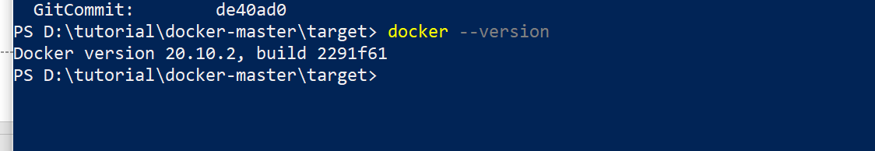
Step 00 - Installing Docker
https://docs.docker.com/install/
Need to install Visual C++ redistributable for windows
Check if your docker is installed by running command:
docker --version
-> Ok

Slide 48
Step 01 - A simple Docker use case - Run mysql
Run command to pull down the mysql image:
docker pull mysql:5.7
5.7 -> tag
You can specify which version you want to use
https://hub.docker.com/_/mysql?tab=tags&page=1&ordering=last_updated
link:
https://hub.docker.com/search?q=mysql&source=verified

Slide 49
Step 01 - A simple Docker use case - Run mysql
Starting a MySQL instance by running:
docker run --name mysql_5.7 -e MYSQL_ROOT_PASSWORD=root -d mysql:5.7
--name mysql_5.7 -> container name
-e MYSQL_ROOT_PASSWORD=root -> password for mysql
-d -> detach mode running command in background
mysql:5.7 -> name:tag of the image

Slide 50
Step 01 - A simple Docker use case - Run mysql
Get into the interaction mode of the container
docker exec -it mysql_5.7 bash
exec: run a command in a running container
-it: interactive mode by allocating a terminal – debugging
Play with mysql
mysql -u root -p
CREATE DATABASE dbname
Link
https://docs.docker.com/engine/reference/commandline/container_exec/
Notes:
Password: root by default

Slide 51
Step 02 - Playing with Docker - Containers and Images
List running containers:
docker ps
List all containers
docker container ls
Restart a container:
docker restart mysql_5.7
Stop a container:
docker stop mysql_5.7
Remove a container:
docker rm mysql_5.7
Stop it first before removing

Slide 52
Step 02 - Playing with Docker - Containers and Images
List all the images
docker images
Remove image
docker image rm [image name]

Slide 53
Step 03 - Manually creating a docker image
Context: I have a simple web application written in Java. I would like to deploy it in a docker image.
Prepare a jar package
Code can be found: https://github.com/shaoweiwang2010/SE_course_docker/tree/master/target
Test the jar in local machine
java -jar .\docker-in-5-steps-todo-rest-api-h2-1.0.0.RELEASE.jar
Try http://localhost:5000/hello-world

Slide 54
Step 03 - Manually creating a docker image
Copy the jar into a Java container and set up to run the jar when launching up
Pull and run a Java container docker
docker run --name openjdk_8 -dit -p 5000:5000 openjdk:8-jdk-alpine
-p how host’s port binds to docker container’s port
Copy jar into running container
docker container cp .\docker-in-5-steps-todo-rest-api-h2-1.0.0.RELEASE.jar openjdk_8:/tmp
docker exec openjdk_8 ls tmp
docker exec -it openjdk_8 /bin/sh
Run the jar in container
docker exec openjdk_8 java -jar tmp/docker-in-5-steps-todo-rest-api-h2-1.0.0.RELEASE.jar
Notes:
docker run --name openjdk_8 -dit -p 5000:5000 openjdk:8-jdk-alpine
docker container cp .\docker-in-5-steps-todo-rest-api-h2-1.0.0.RELEASE.jar openjdk_8:/tmp
docker exec openjdk_8 ls tmp
docker exec -it openjdk_8 /bin/sh
docker exec openjdk_8 java -jar tmp/docker-in-5-steps-todo-rest-api-h2-1.0.0.RELEASE.jar

Slide 55
Step 03 - Manually creating a docker image
--change='CMD exec java -jar /tmp/docker-in-5-steps-todo-rest-api-h2-1.0.0.RELEASE.jar'
Create an image for the running container and set up to run the jar when launching up
docker container commit --change=‘CMD exec java -jar /tmp/docker-in-5-steps-todo-rest-api-h2-1.0.0.RELEASE.jar’ openjdk_8 webapp:v1
docker container commit: create a new image from a container’s change
--change: apply Dockerfile instruction to the created image
Run a contain from the created image
docker run --name web_app_v1 -dit -p 5000:5000 webapp:v1
https://docs.docker.com/engine/reference/commandline/container_commit/
Notes:
docker container commit --change=‘CMD exec java -jar /tmp/docker-in-5-steps-todo-rest-api-h2-1.0.0.RELEASE.jar’ openjdk_8 webapp:v1-> make sure you have ‘ ‘ in the command
docker run --name web_app_v1 -dit -p 5000:5000 webapp:v1

Slide 56
Step 04 – Push image to docker hub
Create an account in docker hub (https://hub.docker.com/)
Create a repo
Push image to docker hub by logining an pushing
Login
docker login --username=shaoweiwang2020
![important] Re-tag the image to <hub-user>/<repo-name>[:<tag>]
docker tag <existing-image> <hub-user>/<repo-name>[:<tag>]
docker tag webapp:v1 shaoweiwang2020/web_app1:v2
Push to your repo
docker push <hub-user>/<repo-name>:<tag>
docker push shaoweiwang2020/web_app1:v2
Materials
https://docs.docker.com/docker-hub/repos/#:~:text=To%20push%20an%20image%20to,docs%2Fbase%3Atesting%20).
https://stackoverflow.com/questions/41984399/denied-requested-access-to-the-resource-is-denied-docker
Notes:
docker login --username=shaoweiwang2020
docker tag webapp:v1 shaoweiwang2020/web_app1:v2
docker push shaoweiwang2020/web_app1:v2

Slide 57
Create image using Dockerfile
Dockerfile
# Create docker image
FROM openjdk:8-jdk-alpine
VOLUME /tmp
EXPOSE 5000
ADD target/*.jar app.jar
ENTRYPOINT [ "sh", "-c", "java -jar /app.jar" ]
Run this commend in working dir (contain the Dockerfile)
docker build -t myappweb:v2.4 .
Run this commend to run the built dock image
docker run --name web_app_v2.4 -dit -p 5001:5000 myappweb:v2.4
https://docs.sevenbridges.com/docs/upload-your-docker-image-with-a-dockerfile
Notes:
docker build -t myappweb:v2.4 .
docker run --name web_app_v2.4 -dit -p 5001:5000 myappweb:v2.4

Slide 58
reference
Chapter 7 & 8, Jez Humble and David Farley, Continuous Delivery.
https://testsigma.com/blog/how-to-prioritize-test-cases-for-regression-testing/
https://testsigma.com/blog/9-tips-for-selecting-test-cases-for-regression-testing/

Slide 59
Create your image based on existing OS
Ubuntu by running
docker pull ubuntu:trusty-20180412
docker run --name ubuntu_2018 -dit ubuntu:trusty-20180412
Install package by running
docker exec -it ubuntu_2018 /bin/bash
sudo apt update
sudo apt install default-jre
Link
https://hub.docker.com/_/ubuntu?tab=description&page=7&ordering=last_updated

